Slide 1
Reading Further

Slide 2
Administrative Preliminaries
Questions?

Slide 3
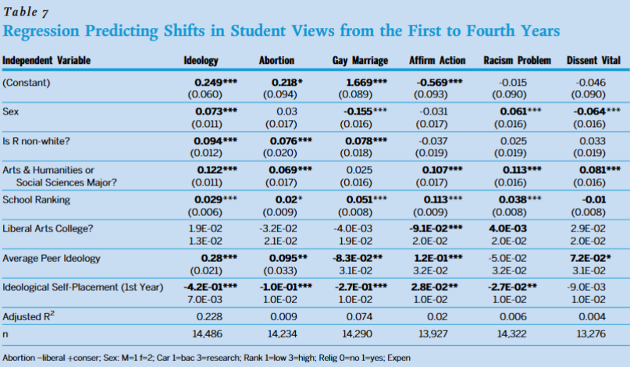

Slide 4
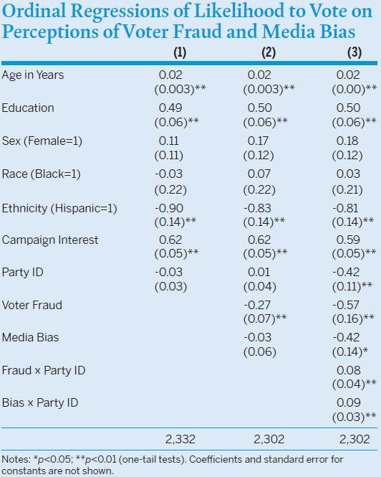

Slide 5
Dependent variable

Slide 6
Dependent variable
Independent variables

Slide 7
Dependent variable
Independent variables

Slide 8
Dependent variable
Independent variables

Slide 9

Dependent variable
Independent variables

Slide 10




Dependent variable
Independent variables

Slide 11
Dependent variable
Independent variables
Coefficient signs

Slide 12
Dependent variable
Coefficient sizes
Independent variables
Coefficient signs

Slide 13
Dependent variable
Coefficient sizes
Independent variables
Statistical confidence
Coefficient signs

Slide 14
Dependent variable
Coefficient sizes
Independent variables
Statistical confidence
Coefficient signs

Slide 16
Statistical Results

Slide 17
Statistical Results
Theory: why would the authors expect some relationship?

Slide 18
Statistical Results
Theory: why would the authors expect some relationship?
Measurement: how were the concepts computed?

Slide 19
Statistical Results
Theory: why would the authors expect some relationship?
Measurement: how were the concepts computed?
Relationships: what variables associate (correlate) with others?

Slide 20
Statistical Results
Theory: why would the authors expect some relationship?
Measurement: how were the concepts computed?
Relationships: what variables associate (correlate) with others?
Confidence: how sure are the authors of their findings?

Slide 21
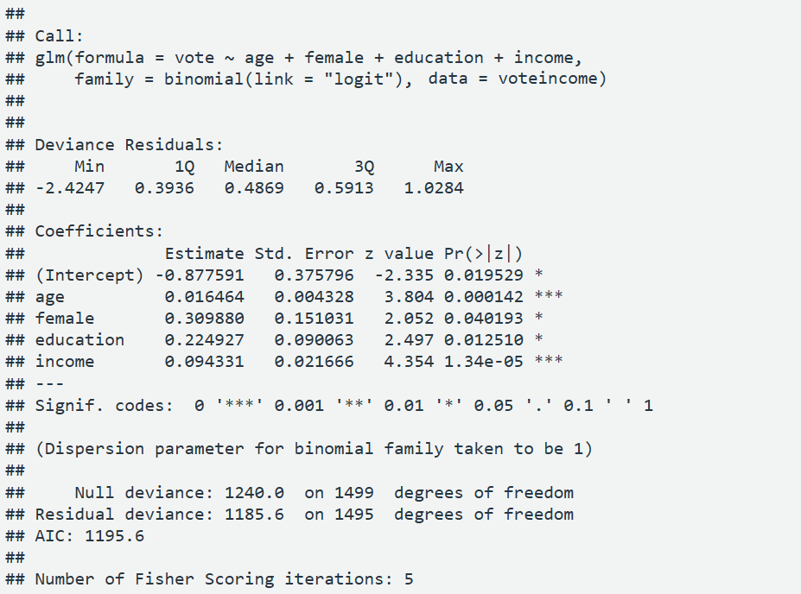

Slide 22
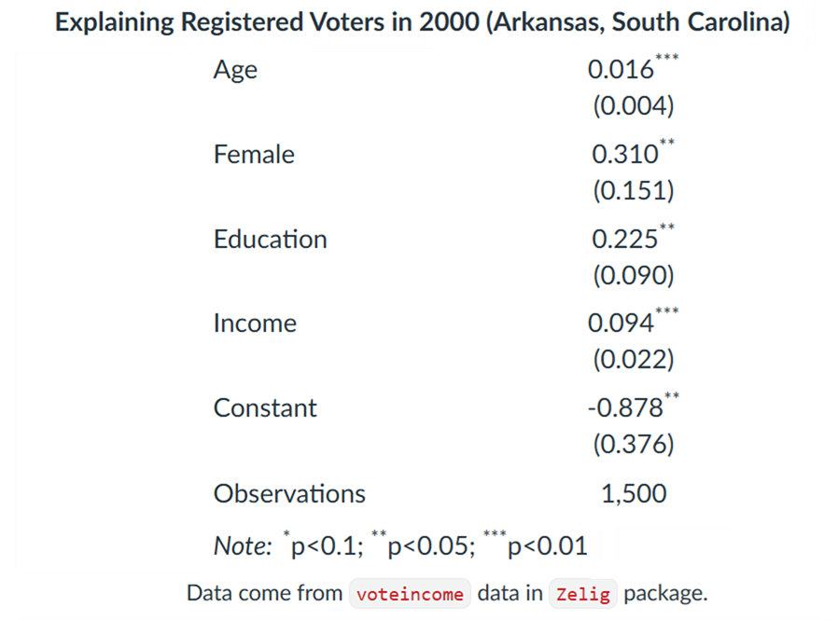

Slide 23
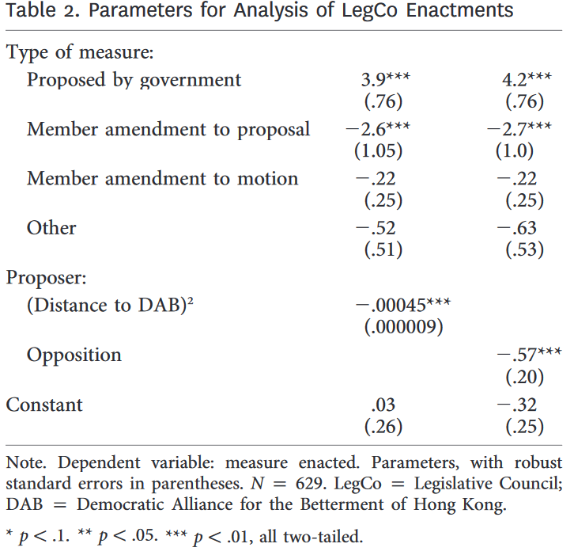
Notes:
From Smyth, Regina, William Bianco, and Kwan Nok Chan. “Legislative Rules in Electoral Authoritarian Regimes: The Case of Hong Kong’s Legislative Council.” Journal of Politics 81:3, 892–905.

Slide 24
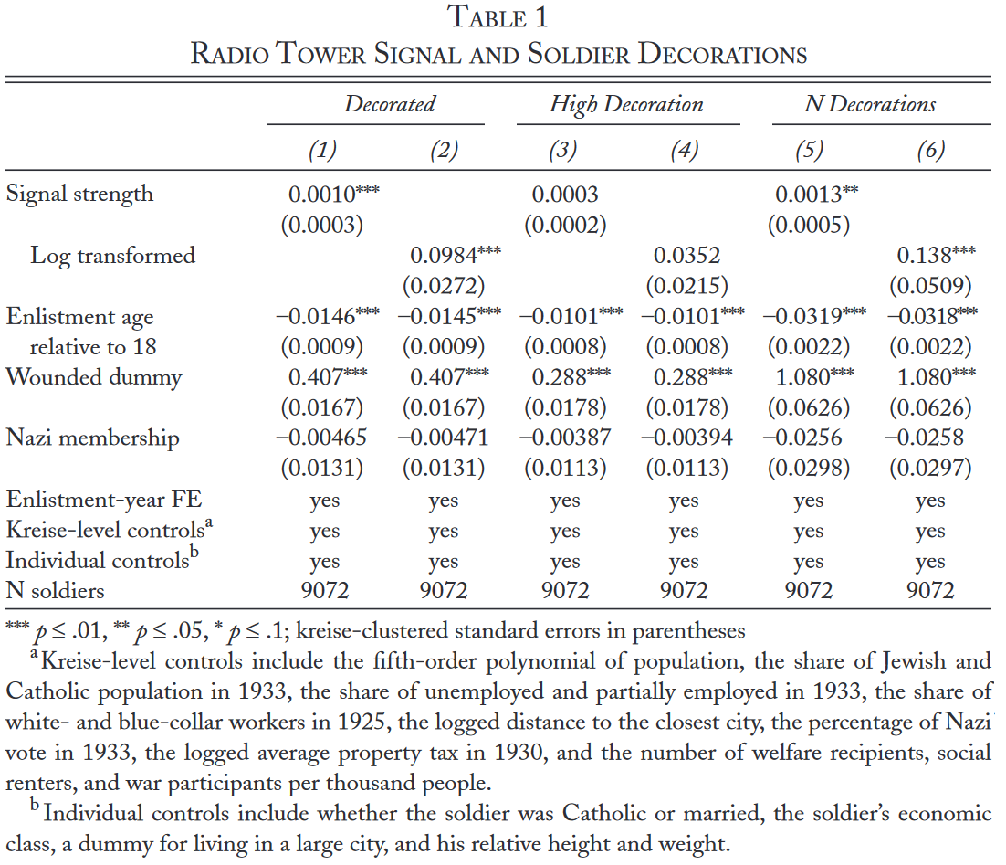
Notes:
From Barber, Benjamin, and Charles Miller. 2019. “Propaganda and Combat Motivation: Radio Broadcasts and German Soldiers’ Performance in World War II.” World Politics 71:3, 457–502.

Slide 25
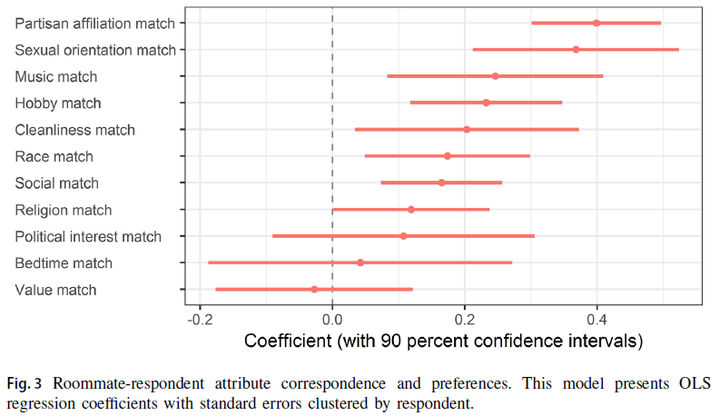
Notes:
From Shafranek, Richard M. 2021. “Political Considerations in Nonpolitical Decisions: A Conjoint Analysis of Roommate Choice." Political Behavior 43:1, 271–300.

Slide 26
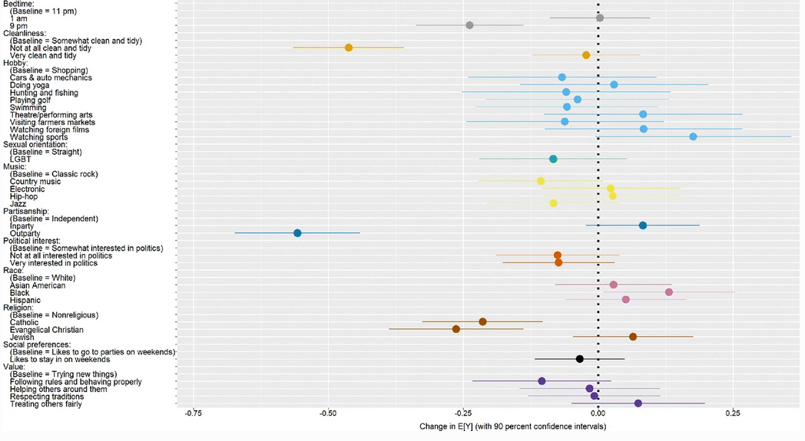

Slide 28
Goldsmith et al.
What are their central claims?

Slide 29
Goldsmith et al.
What are their central claims?
Are those claims surprising? banal? important? generalizable through time?

Slide 30
Goldsmith et al.
What are their central claims?
Are those claims surprising? banal? important? generalizable through time?
Why do they believe their claims: what’s the reasoning?

Slide 31
Goldsmith et al.
What are their central claims?
Are those claims surprising? banal? important? generalizable through time?
Why do they believe their claims: what’s the reasoning?
Does their logic make sense? Is it the logic you would have come up with had you been asked to conjecture why someone might believe this?

Slide 32
Goldsmith et al.
What are their central claims?
Are those claims surprising? banal? important? generalizable through time?
Why do they believe their claims: what’s the reasoning?
Does their logic make sense? Is it the logic you would have come up with had you been asked to conjecture why someone might believe this?
What evidence did they use?

Slide 33
Goldsmith et al.
What are their central claims?
Are those claims surprising? banal? important? generalizable through time?
Why do they believe their claims: what’s the reasoning?
Does their logic make sense? Is it the logic you would have come up with had you been asked to conjecture why someone might believe this?
What evidence did they use?
Is this a good way to study what they’re aiming to? Could you think of alternative ways to get evidence about the question?

Slide 34
Goldsmith et al.
What are their central claims?
Are those claims surprising? banal? important? generalizable through time?
Why do they believe their claims: what’s the reasoning?
Does their logic make sense? Is it the logic you would have come up with had you been asked to conjecture why someone might believe this?
What evidence did they use?
Is this a good way to study what they’re aiming to? Could you think of alternative ways to get evidence about the question?
Are views of the leader interchangeable with views about the country? Is this public diplomacy or personal PR?

Slide 35
Goldsmith et al.
What are their central claims?
Are those claims surprising? banal? important? generalizable through time?
Why do they believe their claims: what’s the reasoning?
Does their logic make sense? Is it the logic you would have come up with had you been asked to conjecture why someone might believe this?
What evidence did they use?
Is this a good way to study what they’re aiming to? Could you think of alternative ways to get evidence about the question?
Are views of the leader interchangeable with views about the country? Is this public diplomacy or personal PR?

Slide 36
Goldsmith et al.
What are their central claims?
Are those claims surprising? banal? important? generalizable through time?
Why do they believe their claims: what’s the reasoning?
Does their logic make sense? Is it the logic you would have come up with had you been asked to conjecture why someone might believe this?
What evidence did they use?
Is this a good way to study what they’re aiming to? Could you think of alternative ways to get evidence about the question?
Are views of the leader interchangeable with views about the country? Is this public diplomacy or personal PR?
Would you expect the effect to be the same regardless of the leader involved?

Slide 37
Goldsmith et al.
What are their central claims?
Are those claims surprising? banal? important? generalizable through time?
Why do they believe their claims: what’s the reasoning?
Does their logic make sense? Is it the logic you would have come up with had you been asked to conjecture why someone might believe this?
What evidence did they use?
Is this a good way to study what they’re aiming to? Could you think of alternative ways to get evidence about the question?
Are views of the leader interchangeable with views about the country? Is this public diplomacy or personal PR?
Would you expect the effect to be the same regardless of the leader involved?

Slide 38
Goldsmith et al.
What are their central claims?
Are those claims surprising? banal? important? generalizable through time?
Why do they believe their claims: what’s the reasoning?
Does their logic make sense? Is it the logic you would have come up with had you been asked to conjecture why someone might believe this?
What evidence did they use?
Is this a good way to study what they’re aiming to? Could you think of alternative ways to get evidence about the question?
Are views of the leader interchangeable with views about the country? Is this public diplomacy or personal PR?
What leader characteristics would you expect to affect the impact of the visit?

Slide 39
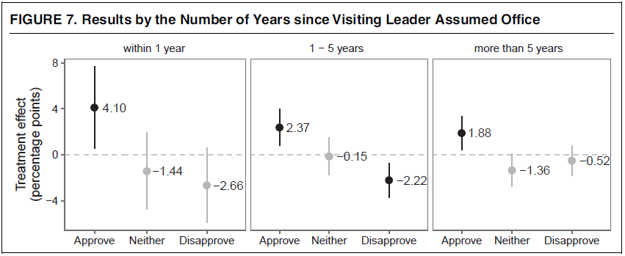
Goldsmith et al.
What are their central claims?
Are those claims surprising? banal? important? generalizable through time?
Why do they believe their claims: what’s the reasoning?
Does their logic make sense? Is it the logic you would have come up with had you been asked to conjecture why someone might believe this?
What evidence did they use?
Is this a good way to study what they’re aiming to? Could you think of alternative ways to get evidence about the question?
Are views of the leader interchangeable with views about the country? Is this public diplomacy or personal PR?
What leader characteristics would you expect to affect the impact of the visit?

Slide 40
Goldsmith et al.
What do they find regarding their central claim? Were they correct?

Slide 41
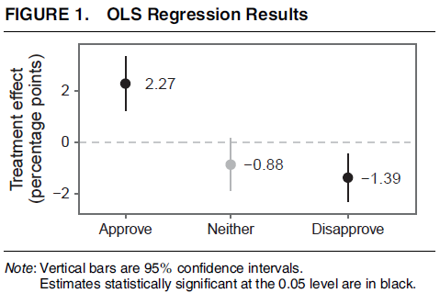
Goldsmith et al.
What do they find regarding their central claim? Were they correct?

Slide 42
Goldsmith et al.
What do they find regarding their central claim? Were they correct?
What does this “2.27” mean substantively? (Is it large?)

Slide 43
Goldsmith et al.
How do we interpret the confidence interval?
What do they find regarding their central claim? Were they correct?

Slide 44
Goldsmith et al.
What do they find regarding their central claim? Were they correct?

Slide 45
Goldsmith et al.
What do they find regarding their central claim? Were they correct?
What else do they find of note, if anything?
“Of note” can mean unexpected, interesting, informative about other questions…

